Slide 1
Data Link Layer Part 2

Slide 2
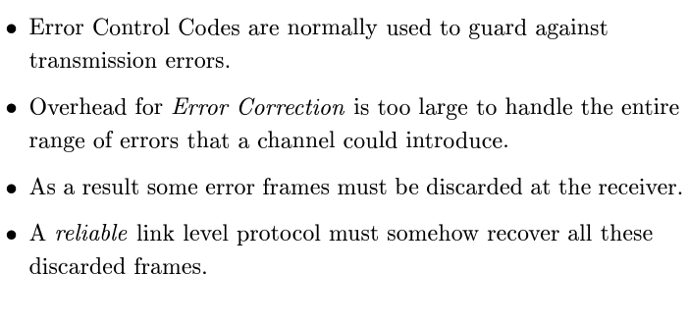
Flow Control (Motivation)

Slide 3
Flow Control
Fast Transmitter
100 Mbps
Slow Receiver
100 Kbps
Link
Receiver is unable to handle the incoming traffic
1. Error
2. Data Lost
Solution is to use flow control techniques.

Slide 4
Flow Control
In practice, errors cause frames to be discarded.
Link level protocols requires to deliver frames reliably and need some recovery mechanism.
It is usually implemented by acknowledgements and time outs.
Algorithm:
Receiver can send acknowledge within a control frame (header without data) or piggybacked in the data frame it is about to send.
If the sender doesn't receive the acknowledgement within a given time, it retransmit the message again.
The retransmission interval is called the timeout period.
This scheme is known as Automatic Repeat Request (ARQ).

Slide 5
Flow Control Protocols
Stop and Wait Protocol: Send the next frame after the acknowledgement of the previous sent frame is arrived the sender.
Sliding Window Protocol (SWP): Send multiple frames without waiting to receive the acknowledgements of previously sent frames to keep the pipe full.

Slide 6
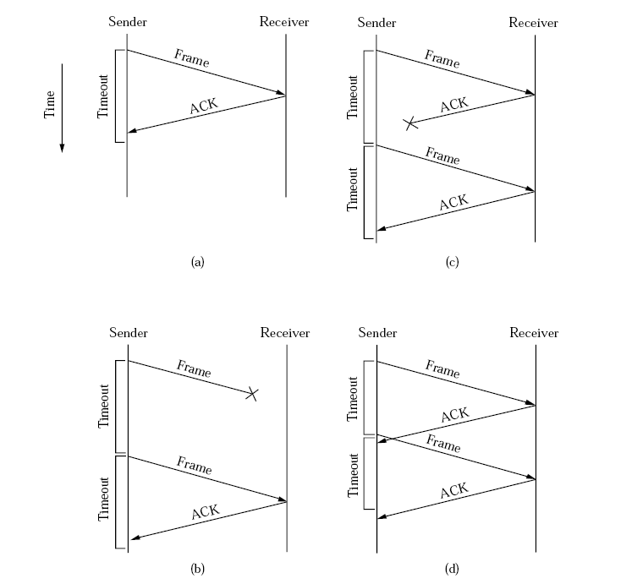
Stop and Wait Protocol Issues
Four different scenarios of stop and wait protocol

Slide 7
Solutions
S/W protocol with 1 bit sequence number alternating on every consecutive frame [0, 1].
If consecutive frames at the receiver have same sequence number → duplicate frames.
This is called the alternate bit protocols.
This do not solve the problem of delayed acknowledgement.
Receiver
Sender
Use n number of bits for sequence number.
Time to live constraint should be added with the acknowledgements.

Slide 8
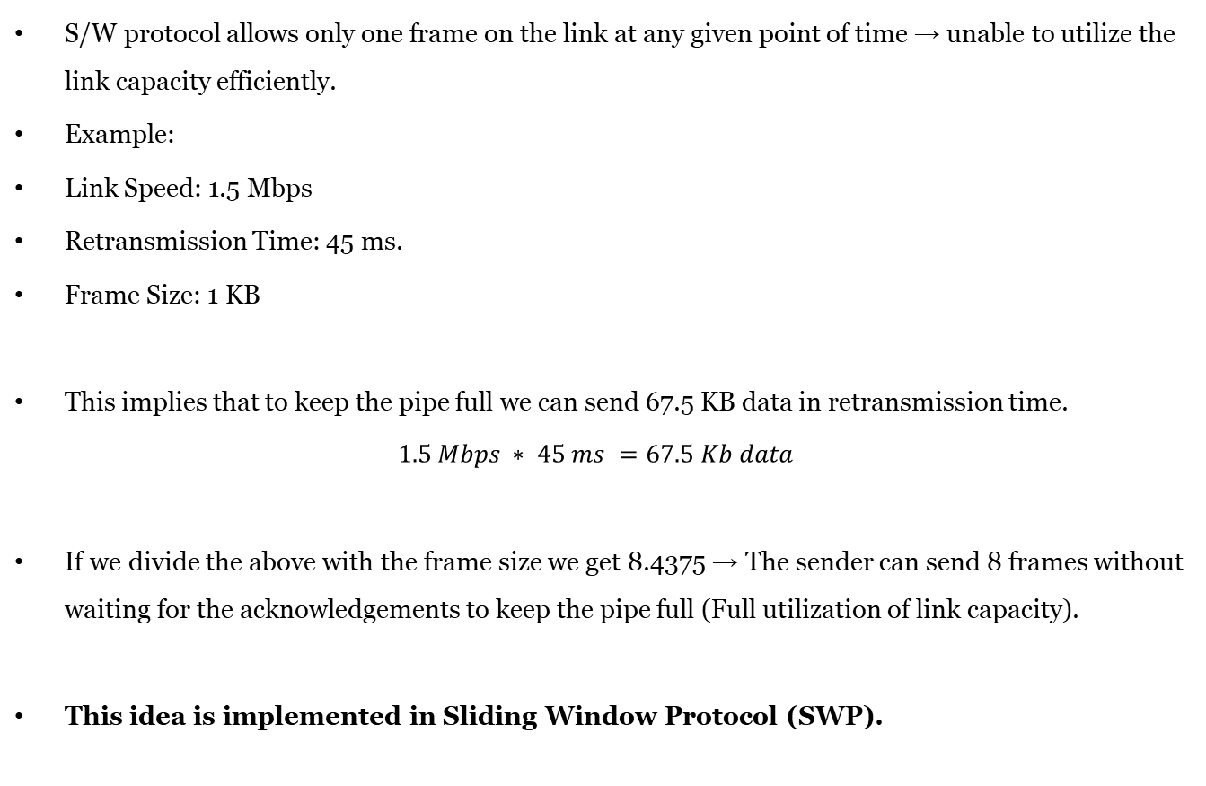
Disadvantages
S/W protocol allows only one frame on the link at any given point of time → unable to utilize the link capacity efficiently.
Example:
Link Speed: 1.5 Mbps
Retransmission Time: 45 ms.
Frame Size: 1 KB
This implies that to keep the pipe full we can send 67.5 KB data in retransmission time.
$$1.5 Mbps ∗ 45 ms =67.5 Kb data$$
If we divide the above with the frame size we get 8.4375 → The sender can send 8 frames without waiting for the acknowledgements to keep the pipe full (Full utilization of link capacity).
This idea is implemented in Sliding Window Protocol (SWP).

Slide 9
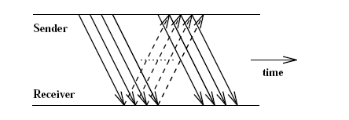
SWP Approach
Basic Idea
Sender transmits up to a given number of frames before expecting an ACK.
In essence more packets are in transmission on the channel.
Therefore, allows multiple outstanding (un-ACKed) frames.
The maximum number of un-ACKed frames allowed on the channel is known as sender’s window size.
Receiver sends back ACKs on receipt of individual frame or sequence of frames.
Allows better use of link capacity - ‘keeping the pipe full’.
Provides frame ordering and flow control utility.

Slide 10
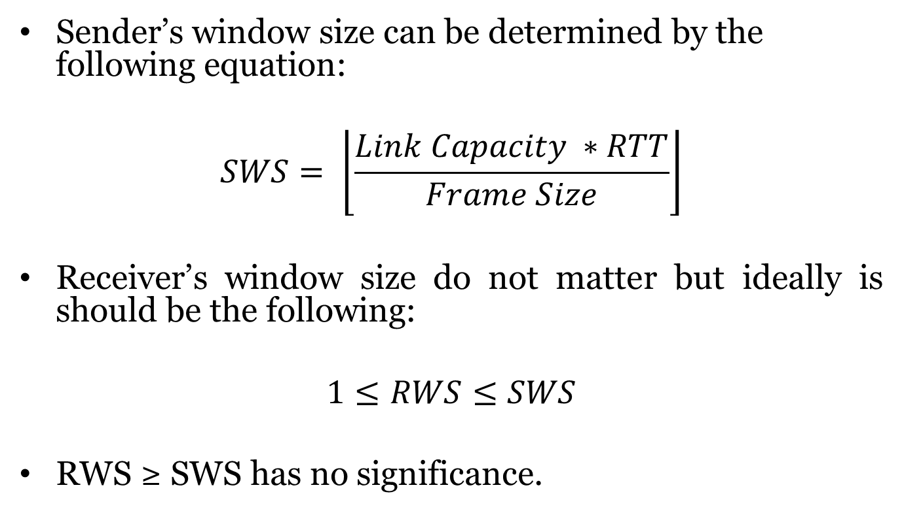
Window Size
Sender’s window size can be determined by the following equation:
$$SWS= \left\lfloor \frac{Link Capacity ∗RTT}{Frame Size}\right\rfloor$$
Receiver’s window size do not matter but ideally is should be the following:
$$1≤RWS≤SWS$$
RWS ≥ SWS has no significance.

Slide 11
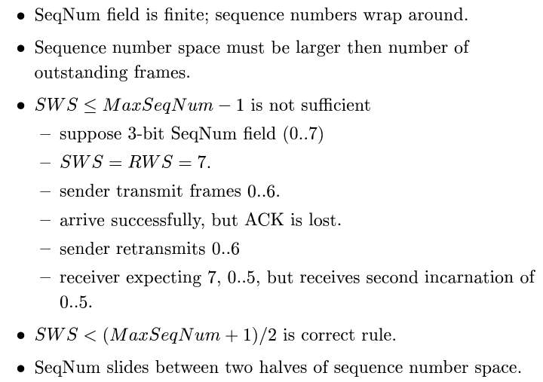
Number of Bits required for the sequence number (Contd.)

Slide 12
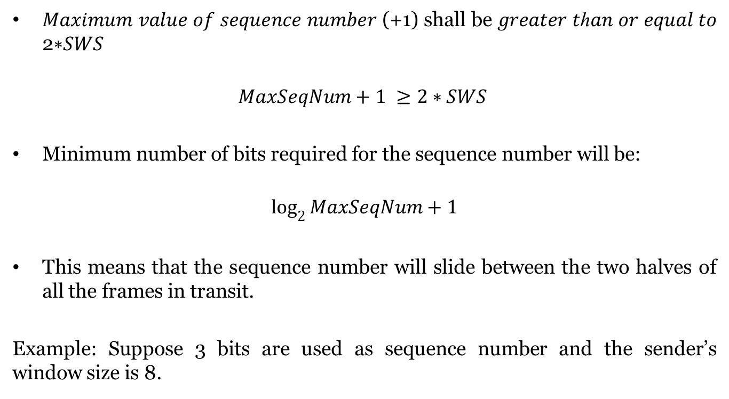
Number of Bits required for the sequence number
𝑀𝑎𝑥𝑖𝑚𝑢𝑚 𝑣𝑎𝑙𝑢𝑒 𝑜𝑓 𝑠𝑒𝑞𝑢𝑒𝑛𝑐𝑒 𝑛𝑢𝑚𝑏𝑒𝑟 (+1) shall be 𝑔𝑟𝑒𝑎𝑡𝑒𝑟 𝑡ℎ𝑎𝑛 𝑜𝑟 𝑒𝑞𝑢𝑎𝑙 𝑡𝑜 2∗𝑆𝑊𝑆
$$MaxSeqNum+1 ≥2∗SWS$$
Minimum number of bits required for the sequence number will be:
$$\log_{2}{MaxSeqNum+1}$$
This means that the sequence number will slide between the two halves of all the frames in transit.
Example: Suppose 3 bits are used as sequence number and the sender’s window size is 8.

Slide 13
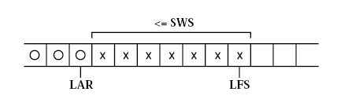
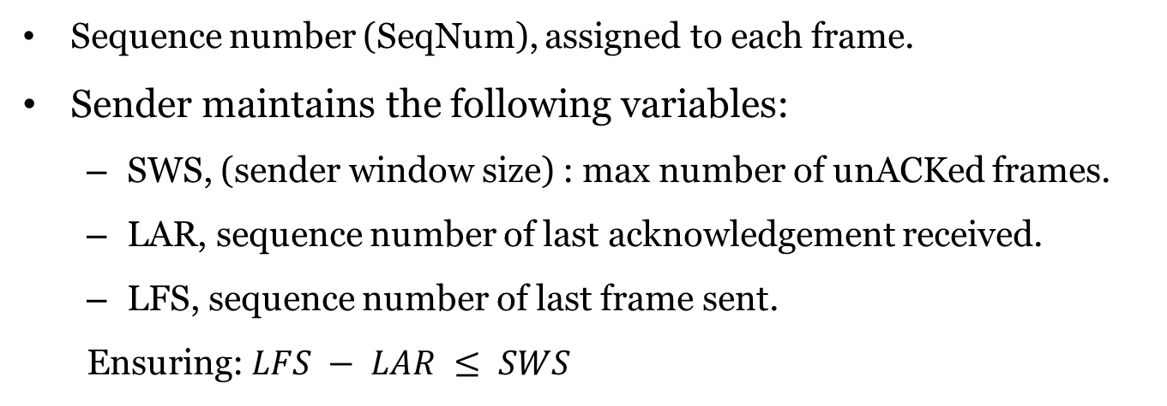
SWP Algorithm (Sender’s Side)
Sequence number (SeqNum), assigned to each frame.
Sender maintains the following variables:
SWS, (sender window size) : max number of unACKed frames.
LAR, sequence number of last acknowledgement received.
LFS, sequence number of last frame sent.
Ensuring: $LFS − LAR ≤ SWS$

Slide 14
SWP Algorithm (Sender’s Side)
Sender transmits frames until LFS - LAR ≤ SWS, ie full window.
After each transmission - increment LFS.
On receipt of ACK:
sender increments LAR.
allowing transmission of another frame.
Timer attached to each frame.
Sender retransmits frame if ACK not received within timeout.
Requires buffering of up to SWS frames.

Slide 15
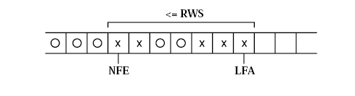
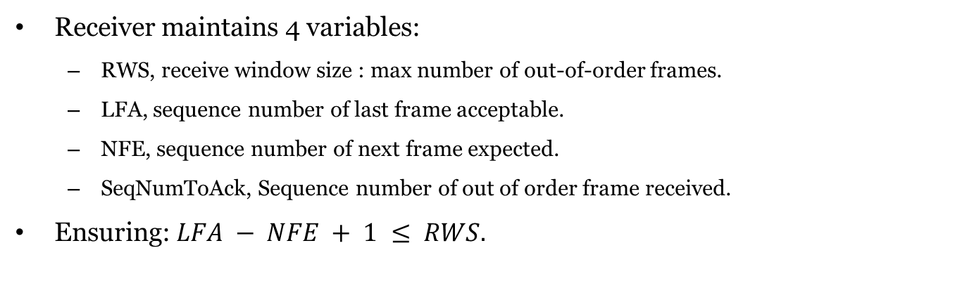
SWP Algorithm (Receiver’s Side)
Receiver maintains 4 variables:
RWS, receive window size : max number of out-of-order frames.
LFA, sequence number of last frame acceptable.
NFE, sequence number of next frame expected.
SeqNumToAck, Sequence number of out of order frame received.
Ensuring: $LFA − NFE + 1 ≤ RWS.$

Slide 16
SWP Algorithm (Receiver’s Side)
Frame arrives with sequence number, SeqNum. Check whether within receive window, discard otherwise.
if NFE ≤ SeqNum ≤ LFA
{
Then accept.
if SeqNum = NFE
then send Ack.
//If out of order frame received
if SeqNum ≠NFE
//This means, out-of-order frame, so buffer SeqNum and await remaining frames.
{ then set SeqNumToAck = SeqNum of out of order frame received
If SeqNum = NFE and all frames ≤ SeqNumToAck received
ACK SeqNumToAck (cumulative ACK).
Set NFE = SeqNumToAck + 1 and LFA = SeqNumToAck + RWS
}}
If SeqNum < NFE or SeqNum > LFA
Then discard.

Slide 17
Advantages of SWP
Sliding window protocol serves three roles.
Reliable transmission - main role.
Frame order preservation:
receiver buffers out-of-order frames
frame passed up only after passing frames with smaller SeqNum.
ensures higher protocol receives frames in correct order
Flow control:
SWP can include ‘feedback’ to ensure receiver isn’t overloaded
with ACK, receiver sends ‘buffer spaces remaining’
avoids sender transmitting ‘out-of-window’ traffic

Slide 18
Sliding Window Protocol Example

Slide 19
Variants of SWP
Duplicate Ack (DAK)
Negative ACK (NAK)
Selective ACK (SAK)
Cumulative ACK (CAK)

Slide 20
Medium Access Control Sublayer

Slide 21
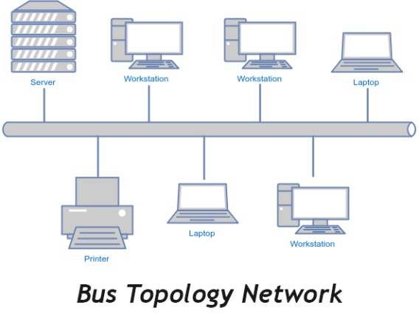
Motivation
Data Link Layer
Logical Link Control Sublayer
Medium Access Control Sublayer
Medium access control sublayer is required when multiple stations are sharing the medium.
It is possible that two stations start transmitting their data at a particular point of time → Collision
Collision is a phenomena when two signal overlap in time on the same communication channel.
To deal with the collision MAC protocol is required.

Slide 22
Motivation
MAC sublayer is not important in point to point network.
But in real world, links are shared by the multiple hots. There is no dedicated unique channel between the two shots.
Any pair of hosts can borrow the link for direct communication.
MAC sublayer is mandatory in all the shared link (multi-point) network.
Example: Ethernet, Token Ring, Token Bus, WLAN, WPAN etc.
Most of the MAC protocols are defined by IEEE 802.x standards. Where x= 1, 2, 3 ..

Slide 23
IEEE 802.x standards
IEEE 802: Overview and Architecture
IEEE 802.1: Management and Bridging
IEEE 802.2 Logical Link Control
802.3 Ethernet | 802.4 Token Bus | 802.5 Token Ring | … | 802.11 WLAN | … | 802.15 WPAN | … | MAC Sublayer
 |  |  |  |  |  |  |  | Physical Layer
Note: IEEE 802.x standards are coving the MAC sublayer and Physical layer of TCP/IP reference Model.

Slide 24
Ethernet (IEEE 802.3)
History
Developed by Xerox PARC in mid of 1970.
Roots in Aloha packet radio network
Initially 3 Mbps baseband coaxial cable (thick Ethernet) was proposed in 1974.
Standardized by Xerox, DEC and Intel in 1978.
IEEE Adopted the standard and named it IEEE802.3 (Ethernet) in 1980s.
Many variants of IEEE 802.3 is available in the market like Fast Ethernet, Gigabit Ethernet etc.

Slide 25
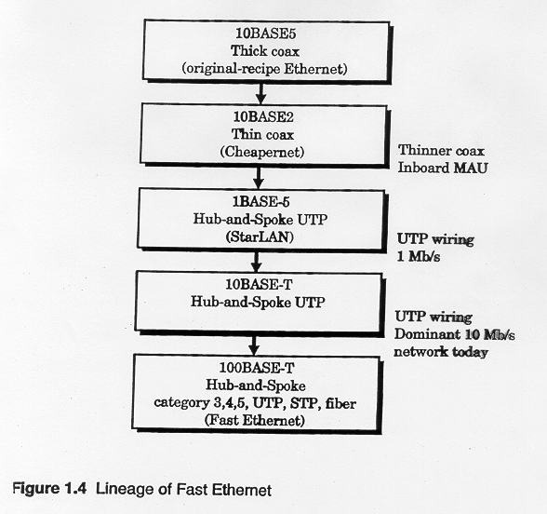
Ethernet variants

Slide 26
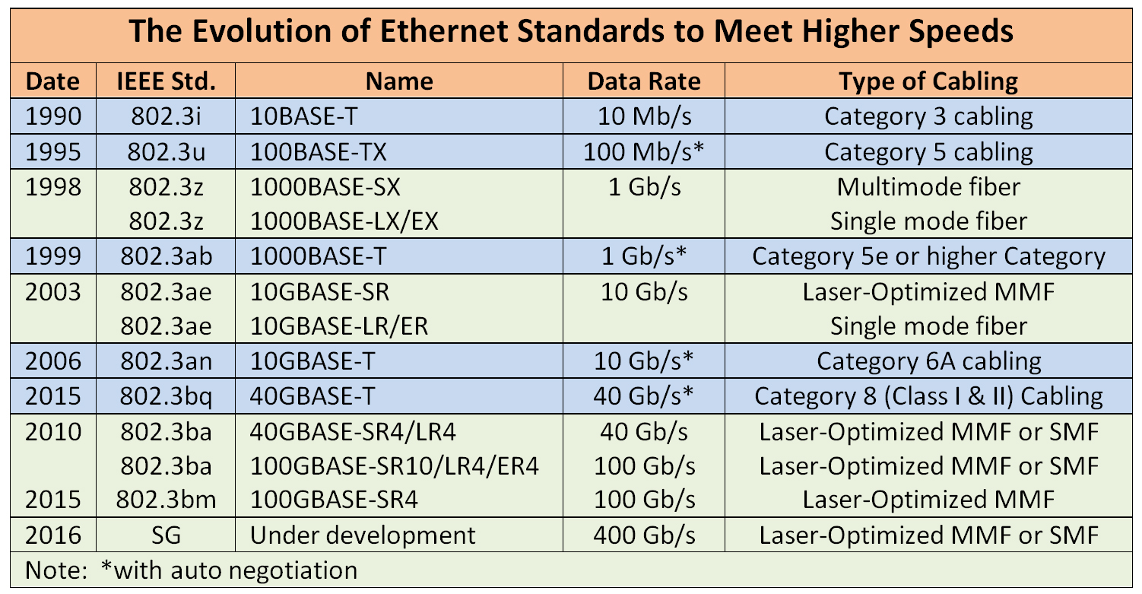
Ethernet variants

Slide 27
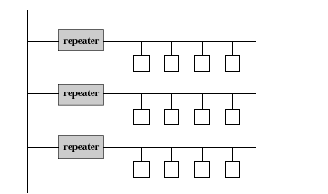
Physical Properties (initial Version)
Ethernet segment - up to 500m of 50 coaxial cable.
Hosts tap into cable for connection, > 2.5 m apart.
Transceiver detects ‘idle’ line and transmits signals onto link.
Transceiver connects to Ethernet adaptor (plugs into host) - implements the Ethernet protocol.
Signals placed on link are broadcast over entire network.
Terminators at end of segments prevent reflections.
Manchester encoding used. Multiple segments joined by repeaters.
Repeaters ‘forward’ signals, avoiding problems with signal decay.
But, no more than four repeaters between any pair of hosts.
Hence max length = 2500m, eg using 2 repeaters between hosts:

Slide 28
MAC Protocol
Multiple access network - nodes send and receive frames over a shared link.
MAC Protocol: 1-persistent, CSMA-CD with Binary Exponential Backoff
Carrier sense - all nodes are able to determine when link is ‘idle’ or ‘busy’.
Multiple Access: More than one node can access the medium at any point of time.
Collision detect - nodes able to detect if frame being transmitted has interfered with frame being transmitted by another node.

Slide 29
Collision Detection (Worst Case)
A begins to
transmit at
t=0
A
B
B begins to
transmit at
t= t_{prop}-δ;
B detects
collision at
t= t_{prop}
A
B
A
B
A detects
collision at
t= 2 t_{prop}-δ
It takes 2 t_{prop} to find out if channel has been captured

Slide 30
Collision Detection (Worst Case)
Frame seizes the channel after 2 t_{prop}
On 1 km Ethernet, t_{prop} is approximately 51.2 microseconds.
Contention interval = 2 t_{prop}
Interframe gap = 9.6 microseconds
Modeled as slotted scheme with slot = 2 t_{prop}

Slide 31
MAC Protocol
Assume an adaptor has a frame to transmit.
If link ‘idle’ - transmit immediately at the start of next slot.
If link ‘busy’ - wait for ‘idle’, then transmit immediately.
Two adaptors may transmit simultaneously - collision occurs.
On detecting collision, adaptor transmits 32-bit jamming sequence to warn other transmitting nodes of collision.
But - to ensure every node detects jamming sequence:
all nodes need to at least ‘fill the pipe’
max Ethernet RTT is 51.2 us, at 10 Mbps →512 bits
ensures jamming sequence gets to each node before end of transmission.
Hence data field must be ≥ 46 bytes:
header (14) + data (46) + CRC (4) = 64 bytes = 512 bits →Minimum 46 bytes required in the data part of a frame.

Slide 32
MAC Protocol
Both transceivers detect collision and stop transmission.
Each adaptor then waits for random amount of time (up to given maximum) before retransmitting based on the binary backoff algorithm.
An adaptor gives up after given number of attempts.

Slide 33
Binary Exponential Backoff Algorithm
Upon a collision, the sending stations increment a local counter K.
The backoff interval is randomly selected using a uniform distribution over the L = 2^{K} slots.
K is initially set to 0.
Thus upon collision, the value of L is doubled locally for each sending station.
Maximum number of retransmission is restricted to 16.

Slide 34
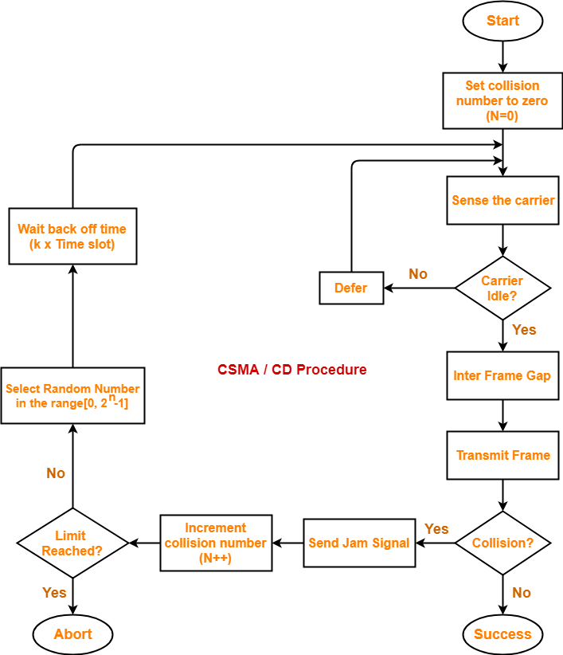
Flowchart of the Algorithm

Slide 35
802.3 MAC Frame
Min:46
Max:1500
7
1
2 or 6
2 or 6
2
4
Preamble
Destination
Address
Source
Address
Length
Information
Pad
FCS
SD
Synch
Start
frame
46 to 1518 bytes

Slide 36
Ethernet Frame
7
1
6
6
2
4
Preamble
SD
Destination
Address
Source
Address
Type
Information
Pad
FCS
Synch
Start
frame
46 to 1518 bytes

Slide 37
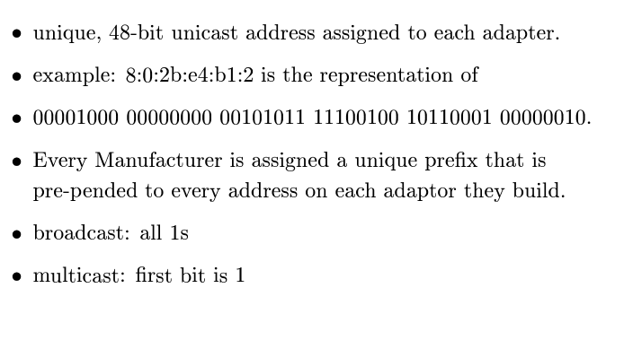
Ethernet Address

Slide 38
Ethernet Address
11001100 11001100 11001100 11001100 11001100 11001100
2a:3b:fe:4c:5b:88
Destination address is either single address
or group address (broadcast = 111...111)
Addresses are defined on local or universal basis
2⁴⁶ possible global addresses
0
Single address
1
Group address
0
Local address
1
Global address

Slide 39
Ethernet: Performance and Popularity
Ethernet performs best under light load (<30%).
Heavy use - too many collisions.
But, most Ethernets are used well under capacity, eg fewer than max hosts, shorter lengths, etc.
Why is Ethernet successful?
easy to administer and maintain.
easy to add extra hosts
inexpensive: cable + adaptors

Slide 40
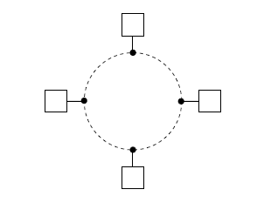
Main alternative to Ethernet for shared access network.
Most general: Fiber Distributed Data Interface (FDDI).
Nodes connected in ring and operate as ring, ie not as pt-to-pt links configured in loop.

Slide 41
Token Rings: Sharing Access
Token (bit pattern) circulates around ring: nodes receive from upstream and pass on downstream.
Node wishing to transmit:
takes token off ring, ie does not pass token downstream.
forwards frame to downstream neighbour (inserts data into ring).
Nodes pass frame around ring, with destination node keeping copy.
Freeing the ring:
when frame reaches sender (one round trip), sender keeps frame and forwards token to downstream neighbour.
downstream nodes can then grab token - round robin sharing.

Slide 42
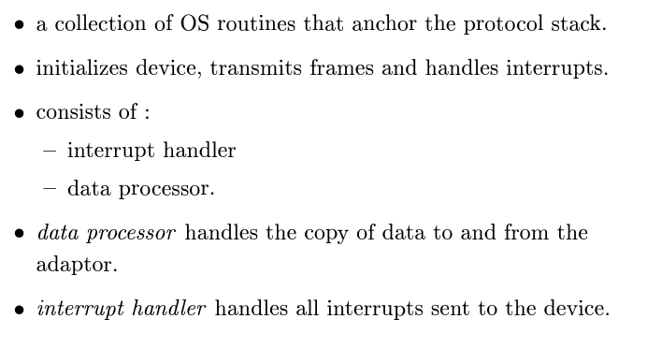
Device Driver

